Slide 1
Banking Management System in Python using OOP’S Concepts
By Priyanshu B. Manke

Slide 2
Project Overview:-
1] About the Project
A mini Banking Management System built using Python and Object-Oriented Programming (OOP).
Implements three main account types:
BankAccount (base class with common features)
SavingsAccount (adds interest handling)
CurrentAccount (adds overdraft facility)
2] Key Features
Deposit & Withdraw operations with validations.
Balance Enquiry using encapsulation (private balance attribute).
Interest Calculation for savings accounts.
Overdraft Facility for current accounts.

Slide 3
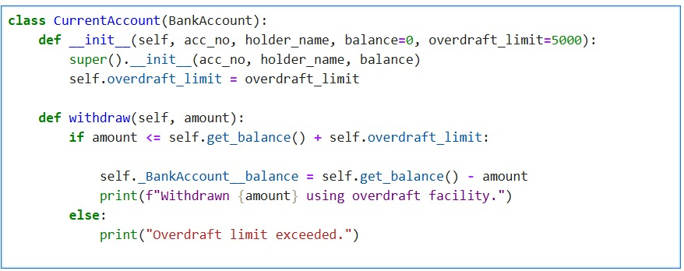
CurrentAccount – With Overdraft:-
Class Declaration
CurrentAccount inherits from BankAccount. It adds an extra feature: overdraft facility.
Constructor (__init__)
Calls parent constructor with acc_no, holder_name, and balance.
Defines self.overdraft_limit (default = 5000).
Withdraw Method
Checks if amount ≤ (current balance + overdraft_limit).

Slide 4
Oop’s Concept Used:-
1. Encapsulation
Wrapping data (variables) and methods into a single unit (class).
Protects data using private attributes (e.g., __balance).
2. Inheritance
One class derives properties and methods from another.
Example: SavingsAccount and CurrentAccount inherit from BankAccount.
3. Polymorphism
Same method name behaves differently in different classes.
Example: withdraw() works uniquely in BankAccount, SavingsAccount, and CurrentAccount.
4. Abstraction
Hiding internal details and showing only essential features.
Users only call deposit(), withdraw(), get_balance() without knowing the implementation.

Slide 5
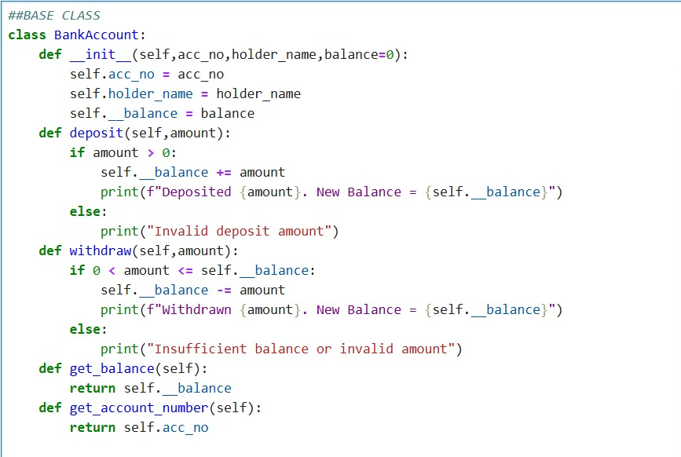
BankAccount – Core Class
1] __init__: Initializes account details & private balance.
2]deposit: Adds money with validation.
3]withdraw: Deducts money only if funds are sufficient.
4]get_balance: Safely returns the private balance.

Slide 6
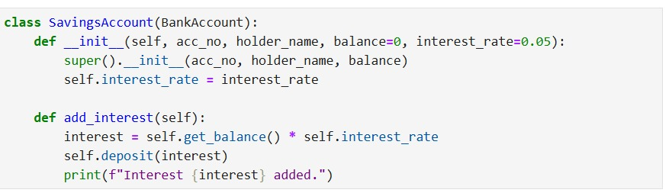
SavingsAccount – With Interest
Class Declaration
SavingsAccount inherits from BankAccount → it has all features of the base class (deposit, withdraw, get_balance).
- Constructor (__init__)
Accepts acc_no, holder_name, initial balance (default = 0), and interest_rate (default = 5% or 0.05).
Calls super().__init__() → this initializes the parent BankAccount attributes.
Defines self.interest_rate → unique to SavingsAccount.
- add_interest() Method
Calculates interest = current balance × interest rate.
Uses self.deposit(interest) → adds the interest amount to the account.
Prints a confirmation message showing how much interest was added.

Slide 7
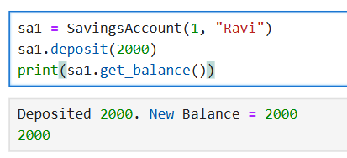
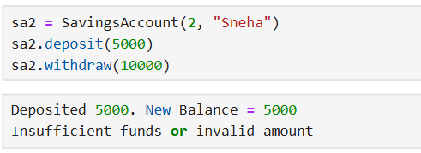
Example Runs & Outputs
1] SavingsAccount – Deposit & Balance Check
2] SavingsAccount – Insufficient Balance Withdraw

Slide 8
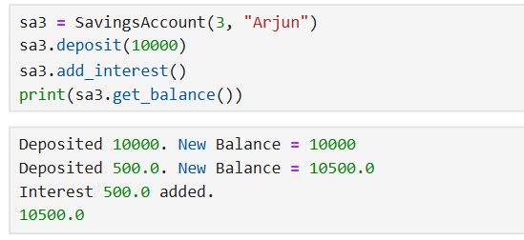
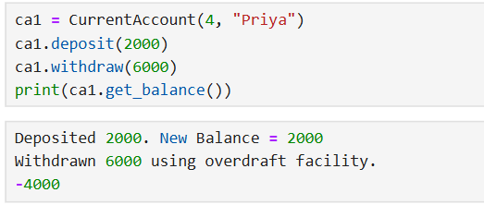
3] SavingsAccount – Add Interest
4] CurrentAccount – Withdraw with Overdraft

Slide 9
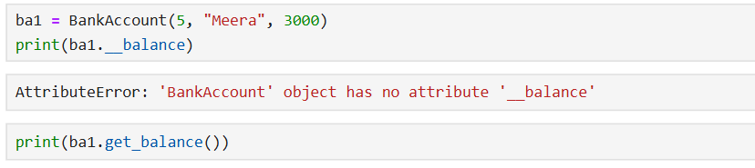
5]Encapsulation Test – Direct Balance Access

Slide 10
Conclusion:-
Object-Oriented Programming (OOPs) principles simplify real-world problems like banking systems.
Encapsulation secures account details by restricting direct access to sensitive data (e.g., balance).
Inheritance allows code reusability by extending the core BankAccount class into SavingsAccount and CurrentAccount.
Polymorphism ensures that the same method (e.g., withdraw) behaves differently depending on the account type.
Abstraction hides complex implementation details and provides user-friendly methods (deposit, withdraw, add_interest).
Overall, OOP makes the system modular, scalable, and maintainable, closely reflecting real-world banking operations.

Slide 11
THANK YOU

